Slide 1
CSE 486/586 Distributed Systems Mid-Semester Overview
Steve Ko
Computer Sciences and Engineering
University at Buffalo

Slide 2

We’re at a Mid-Point: What We’ve Discussed So Far
Main communication infrastructure: the Internet
Communication between two processes
Socket API
RPC
Communication between multiple processes
Multicast algorithms
Concept of time in distributed systems
Organization of distributed systems
Server-client
Peer-to-peer, DHTs
Impossibility of consensus
Distributed algorithms
Failure detection, global snapshots, mutual exclusion, leader election

Slide 3
The Other Half of the Semester
Distributed storage
Consensus algorithm: Paxos
BFT (Byzantine Fault Tolerance)
Security

Slide 4
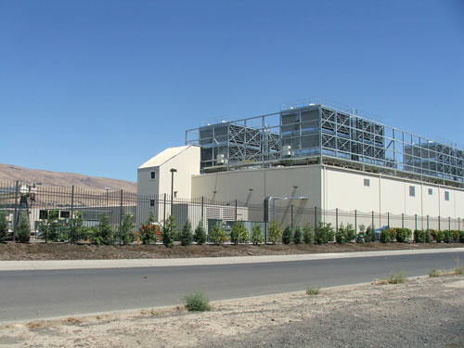
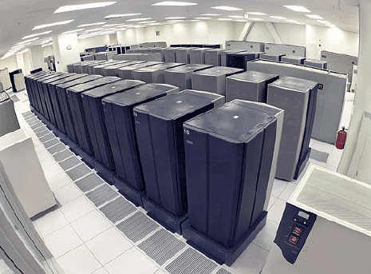
Data Centers
Buildings full of machines

Slide 5
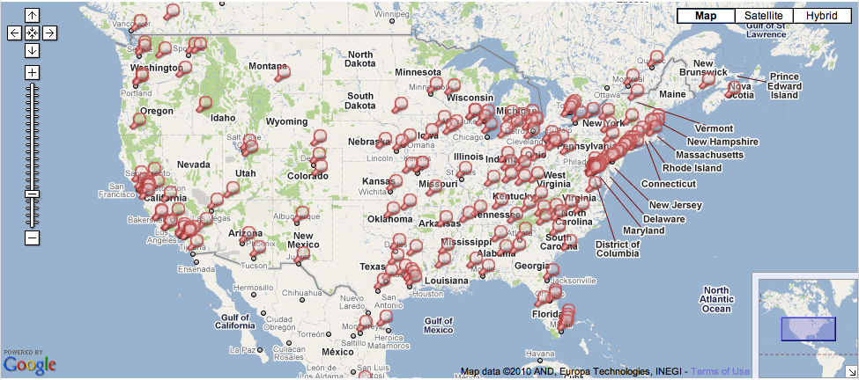
Data Centers
Hundreds of Locations in the US

Slide 6
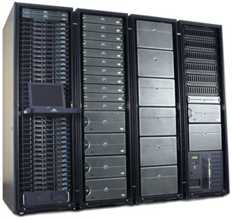
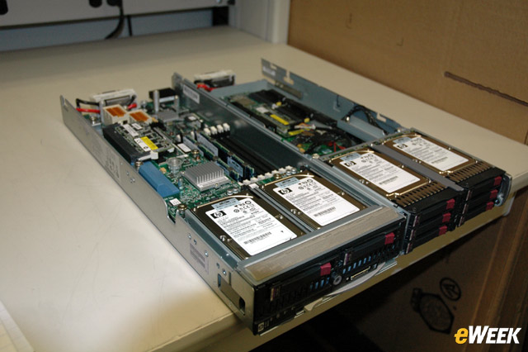
Inside
Servers in racks
Usually ~40 blades per rack
ToR (Top-of-Rack) switch
Incredible amounts of engineering efforts
Power, cooling, etc.

Slide 7
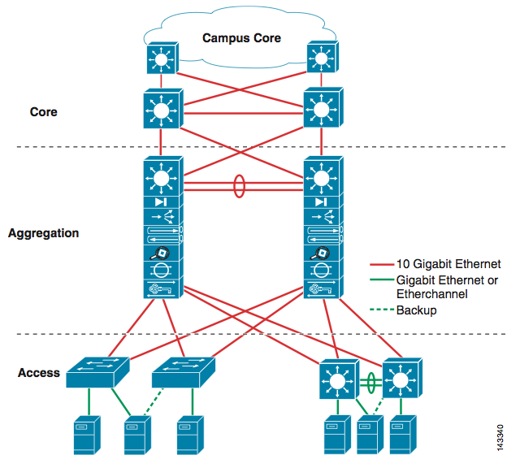
Inside
Network

Slide 8
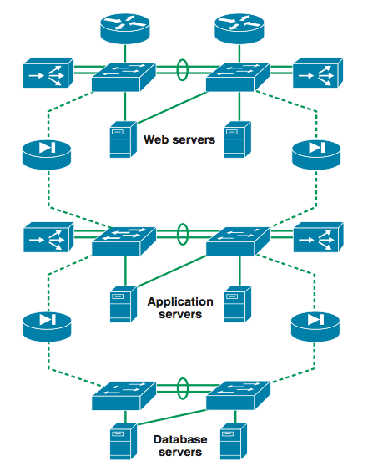
Inside
3-tier for Web services

Slide 9
Web Services
Amazon, Facebook, Google, Twitter, etc.
World-wide distribution of data centers
Load balance, fault tolerance, performance, etc.
Replicated service & data
Each data center might be a complete stand-alone web service. (It depends though.)
At the bare minimum, you’re doing read/write.
What needs to be done when you issue a read req?
Server selection
What needs to be done when you issue a write req?
Server selection
Replicated data store management

Slide 10
Server Selection Primer
Can happen at multiple places
Server resolution process: DNS -> External IP -> Internal IP
DNS
www.facebook.com
69.63.181.11
69.63.181.12
North Carolina
www.facebook.com
69.63.187.17
69.63.187.18
69.63.187.19
California

Slide 11
IP Anycast
BGP (Border Gateway Protocol) level
Hey, I know where 69.63.187.17 is…
in New York
Hey, I know where 69.63.187.17 is…
in California

Slide 12
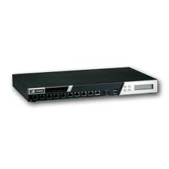
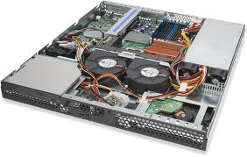
Inside
Load balancers
69.63.176.13
10.0.0.1
10.0.0.2
10.0.0.200
Web Servers

Slide 13
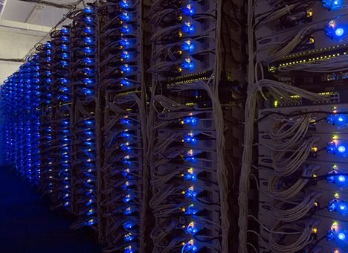
Example: Facebook
www.facebook.com
69.63.176.13
69.63.176.14
Oregon
69.63.181.11
69.63.181.12
North Carolina
69.63.187.17
69.63.187.18
69.63.187.19
California

Slide 14
Example: Facebook Geo-Replication
(At least in 2008) Lazy primary-backup replication
All writes go to California, then get propagated.
Reads can go anywhere (probably to the closest one).
Ensure (probably sequential) consistency through timestamps
Set a browser cookie when there’s a write
If within the last 20 seconds, reads go to California.
http://www.facebook.com/note.php?note_id=23844338919

Slide 15
Core Issue: Handling Replication
Replication is (almost) inevitable.
Failures, performance, load balance, etc.
We will spend most of our time looking at this in the second half of the semester.
Data replication
Read/write can go to any server.
How to provide a consistent view? (i.e., what consistency guarantee?) linearizability, sequential consistency, causal consistency, etc.
What happens when things go wrong?
State machine replication
How to agree on the instructions to execute?
How to handle failures and malicious servers?

Slide 16
CSE 486/586 Administrivia
Midterm: 3/6 (Wednesday) in class
45 minutes
Everything up to leader election
1-page cheat sheet is allowed.
Best way to prepare
Read the textbook & go over the slides
Go over the problems in the textbook
Will add more problems for the lectures this week & next
PA3 will be out this weekend.
No recitations next week
Anonymous feedback form still available.
Please come to me!

Slide 17
Today: Banking Example (Once Again)
Banking transaction for a customer (e.g., at ATM or browser)
Transfer $100 from saving to checking account
Transfer $200 from money-market to checking account
Withdraw $400 from checking account
Transaction
savings.deduct(100)
checking.add(100)
mnymkt.deduct(200)
checking.add(200)
checking.deduct(400)
dispense(400)

Slide 18
Wait…We’ve Seen This Before…
What are some things that can go wrong?
Multiple clients
Multiple servers
How do you solve this?
Group everything as if it’s a single step
Where have we seen this?
Mutual exclusion lecture
So, we’re done?
No, we’re not satisfied.

Slide 19
Why Not Satisfied?
Process 1
lock(mutex);
savings.deduct(100);
checking.add(100);
mnymkt.deduct(200);
checking.add(200);
checking.deduct(400);
dispense(400);
unlock(mutex);
Process 2
lock(mutex);
savings.deduct(100);
checking.add(100);
mnymkt.deduct(200);
checking.add(200);
checking.deduct(400);
dispense(400);
unlock(mutex);

Slide 20
Why Not Satisfied?
1. savings.deduct(100)
2. checking.add(100)
3. mnymkt.deduct(200)
4. checking.add(200)
5. checking.deduct(400)
6. dispense(400)
A failure at these points does not cause lost money, but old steps cannot be repeated
A failure at these points means the customer loses money; we need to restore old state

Slide 21
Why Not Satisfied?
What we discussed in mutual exclusion is one big lock.
Everyone else has to wait.
It does not necessarily deal with failures.
Performance
Observation: we can interleave some operations from different processes.
Failure
If a process crashes while holding a lock
Let’s go beyond simple locking!

Slide 22
Acknowledgements
These slides contain material developed and copyrighted by Indranil Gupta (UIUC).

